Slide 1

Java Presentation Inheritance

Slide 2

Submitted By :
Submitted To :
Md. Asadujjaman Noor
20101101
Tanjina Helaly
Anwar Hossain
20101102
Assistant professor
Department of CSE
University of Asia Pacific
Sheikh Nafez Sadnan
20101106

Slide 3
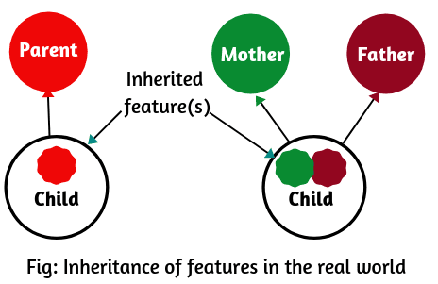
What Is Inheritance
Inheritance is something that is or may be inherited. In our real world, a child inherits the features its parents such as beauty of mother and intelligence of father as shown in the below figure-
Inheritance can form in many ways. We all have some certain characteristics and distinguish characteristics as well. We utilize all the common features for our better living. We adopt our behavior from our closest one. Inheritance is an obvious thing we inherited things from here and there.

Slide 4
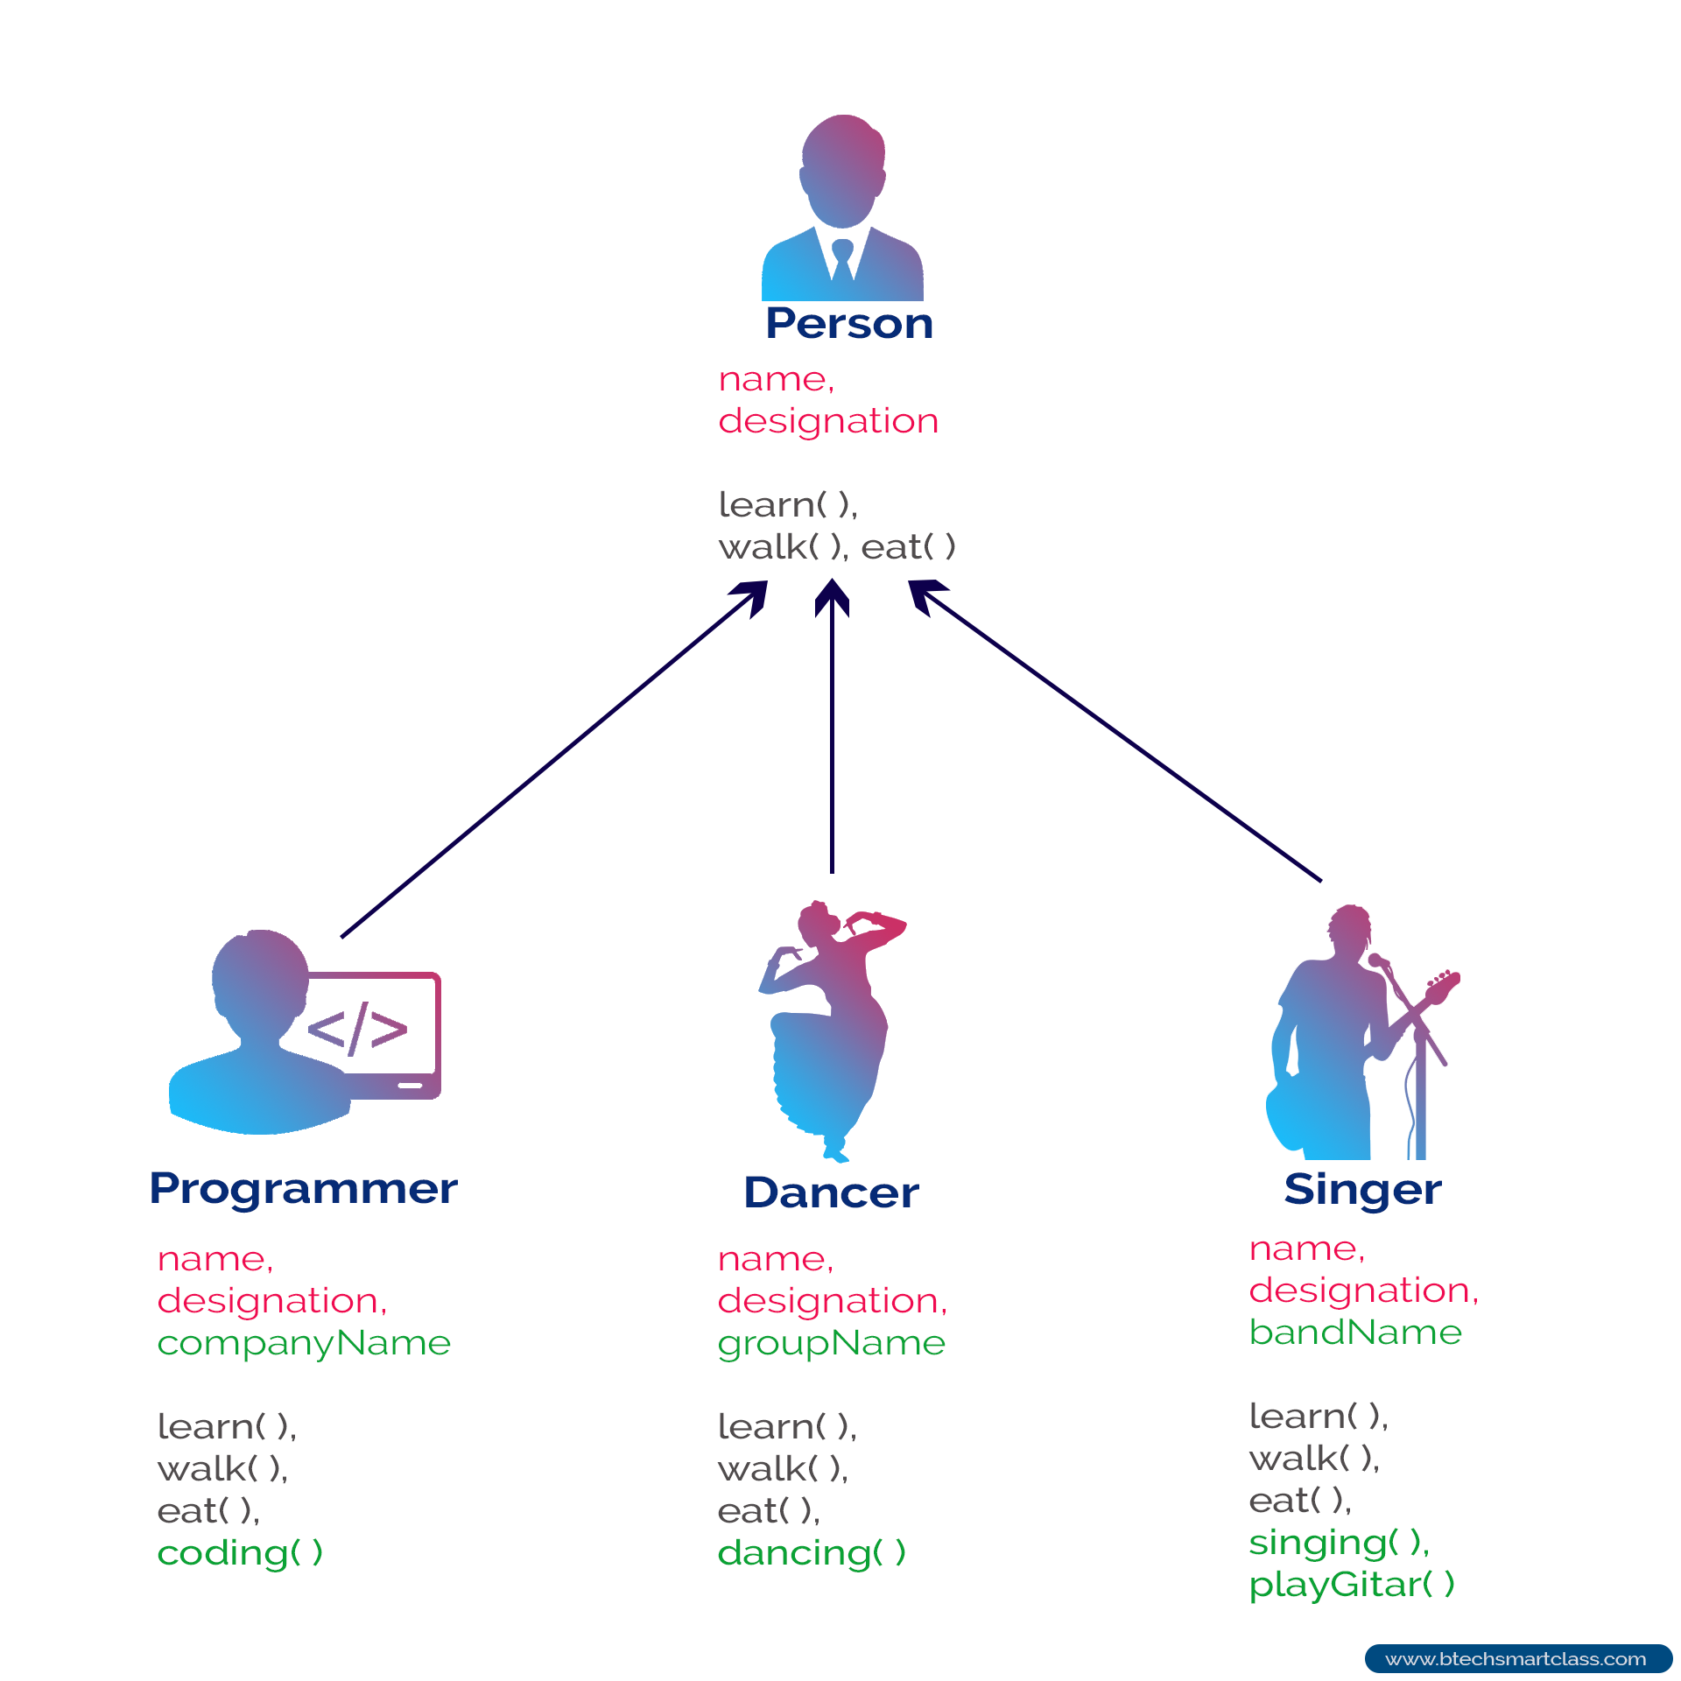
From this picture we see that every kind of person has some general attributes and some individual. That different feature made them unique but they all belongs to the person category for their common features. So it is easy to identify them they all are in person class. So we can say in the real world we are all inherited.
In java inheritance is a process by which a child class acquires all the properties and behaviors of the parent class. This relationship is known as parent-child relationship in java. It makes an inter-connection to all the classes.

Slide 5

Why Inheritance
Question arises why we should use inheritance while using java. Let’s find out below-
Minimization-Inheritance can minimize the amount of duplicate code in an application by sharing common code amongst several subclasses. Reusability - It has facility to use public methods of base class without rewriting the same. Extensibility -It can extends the base class logic as per business logic of the derived class. Data Security - Base class can decide to keep some data private so that it cannot be altered by the derived class. Overriding -With inheritance, we will be able to override the methods of the base class so that meaningful implementation of the base class method can be designed in the derived class.

Slide 6
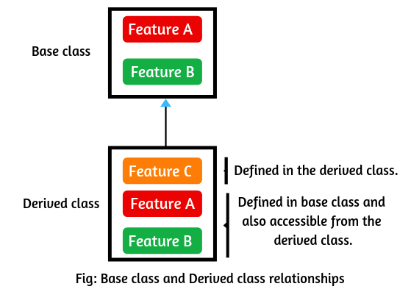
Terms to Know
Superclass/Parent class: The class from where a subclass inherits features is called superclass. It is also called base class or parent class in java. 2. Subclass/Child class: A class that inherits all the members (fields, methods, and nested classes) from other class is called subclass. It is also called a derived class, child class, or extended class.

Slide 7
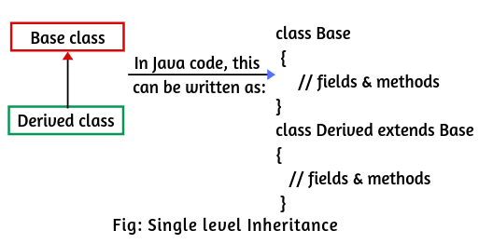
Types of Inheritance
Single Inheritance Creating subclasses from a single base class is called single inheritance.

Slide 8
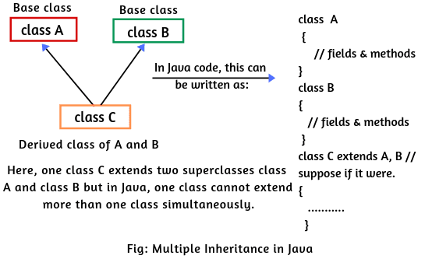


Multiple Inheritance
Defining derived class from numerous base classes is known as Multiple Inheritance.
Java does not support Multiple Inheritance

Slide 9
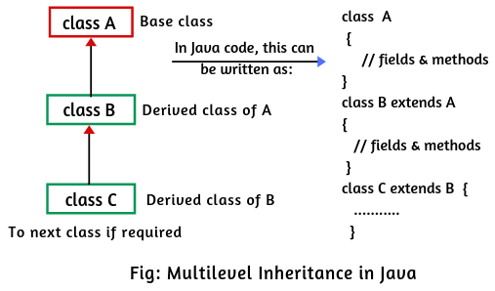
Multilevel Inheritance
In Multi-Level Inheritance, a class extends to another class that is already extended from another class.

Slide 10
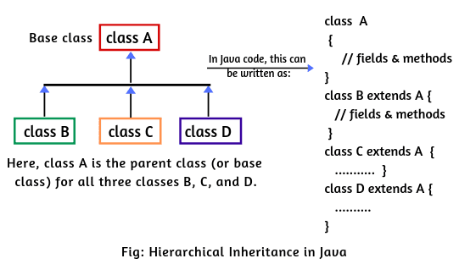
Hierarchical Inheritance
In Hierarchical Inheritance, more than one derived class extends a single base class.

Slide 11
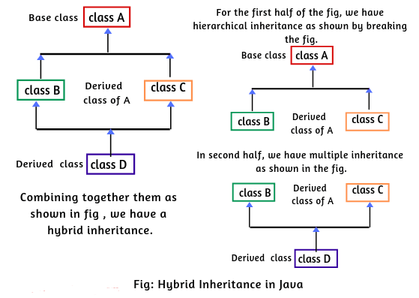
Hybrid Inheritance
Hybrid Inheritance is a combination of Inheritances. In this type of Inheritance, more than one kind of inheritance is observed.

Slide 12
How to Implement in Java
public class Main {
public static void main(String[] args) {
Son object=new Son();
System.out.println(object.Car);
object.Hobby();
object.Job();
}
}
class Father {
int Car = 3;
public void Hobby() {
System.out.println("Love To Traveling All Over The World");
}
}
class Son extends Father {
public void Job(){
System.out.println("Works at Google");
}
}
The System will show :
3
Love To Traveling All Over The World
Works at Google

Slide 13
Any Questions?
Thank You

